Slide 1
Qgis, De-Duplication and Android App Update
Sk Mamud Haque
Aditya Parihar
Under Guidance Of :
Dr. Priya Ranjan
Professor, UPES

Slide 2
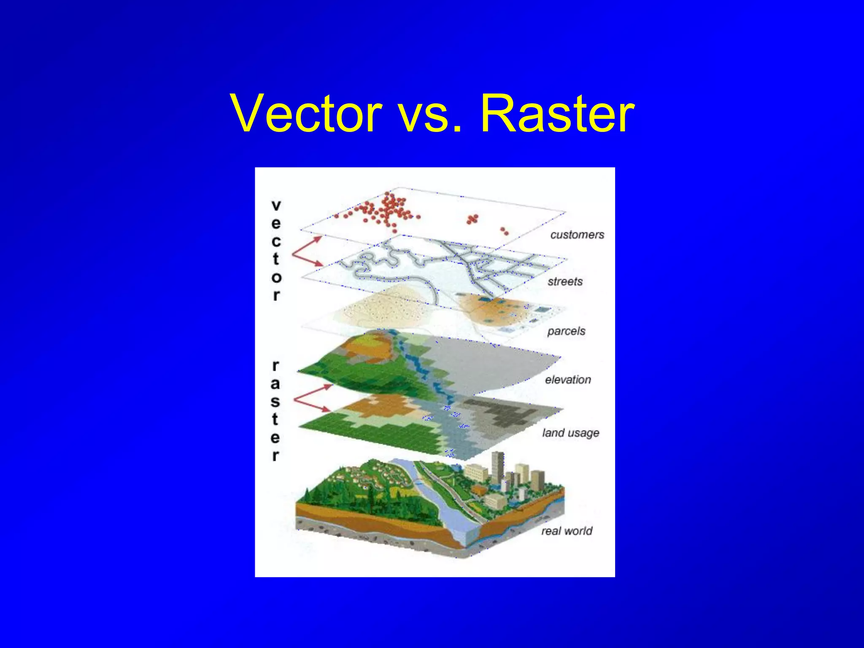
Qgis Description and functionalities
Mapping and Cartography: QGIS provides a robust set of tools for creating and customizing maps. You can design and style maps by adjusting symbology, labels, and colors. The software offers a vast collection of cartographic elements to enhance the visual representation of your data.
Spatial Analysis: QGIS offers a wide range of spatial analysis tools for performing geoprocessing tasks. You can perform operations like buffering, spatial queries, overlay analysis, interpolation, and more. These tools help in deriving meaningful insights and extracting valuable information from your data.
Geoprocessing and Automation: QGIS supports geoprocessing workflows by allowing users to create and run custom scripts using Python. This feature enables automation of repetitive tasks, batch processing, and advanced analysis.

Slide 3
Deduplication in Qgis
deduplication refers to the process of identifying and removing duplicate features or data points from a layer. It involves identifying identical or overlapping features and taking appropriate actions to eliminate redundancy, resulting in a dataset without duplicate information.
The goal of deduplication in QGIS is to ensure data integrity, accuracy, and efficiency in geospatial analysis. By removing duplicates, you can avoid potential errors or biases that may arise from working with redundant data. Deduplication helps to create cleaner datasets, simplifying data management, analysis, and visualization tasks.
It is important to note that deduplication in QGIS focuses on eliminating duplicate features within a single layer. If you have multiple layers with similar or overlapping features, you may need to employ additional spatial analysis techniques or overlay operations to detect and resolve duplicates across layers.

Slide 4
Deduplication Methodology in Qgis
Deduplication Methodology in Qgis
Attribute
Based
Geometry
Based
Plugin
Based
Manual
Based
Spatial
Based
Use the "Select by Expression" tool to identify duplicate features based on specific attribute values.
Utilize the "Delete Duplicate Geometries" tool available in the Processing Toolbox.
The "Semi-Automatic Classification Plugin" (SCP) includes tools like "Cluster Analysis" and "Spatial Clustering" to identify and remove duplicates based on attribute values or spatial proximity.
Visual inspection and manual editing can be performed to identify and remove duplicates from the layer.
Apply spatial operations like "Union," "Intersection," or "Clip" to merge overlapping features or eliminate redundancy and done through vectors.

Slide 5
Steps For Deduplication Process in Qgis
Here's a step-by-step guide to deduplicating two points using layer merging in QGIS:
Open QGIS and load the layer containing the two points you want to deduplicate.
Select the "Vector" menu at the top, then go to "Data Management Tools" and choose "Merge Vector Layers."
In the "Merge Vector Layers" dialog, select your input layer containing the two points.
Ensure the "Select by attribute" option is disabled to merge based on the geometry.
Specify the output file or choose to save the merged layer as a new file.
Click on the "OK" button to start the merging process.
QGIS will merge the two points into a single point, removing any duplicates and creating a deduplicated layer. Keep in mind that this method merges features based on their geometries and not necessarily their attributes.

Slide 6
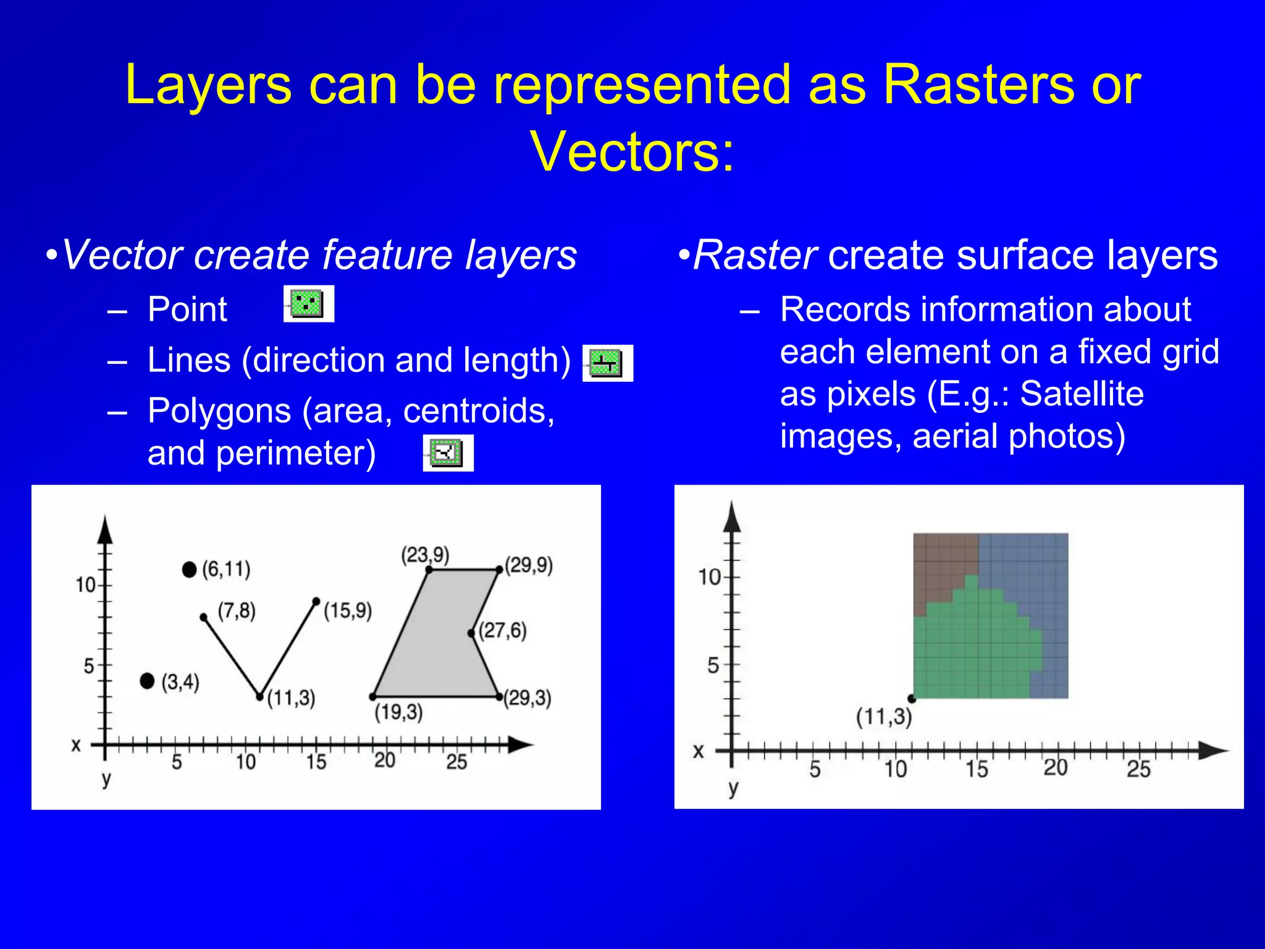

Slide 7
It's important to consider the characteristics of your data and the deduplication requirements to select the most appropriate methodology. Always make sure to create backups of your data before performing any deduplication operations to avoid irreversible changes.
Open QGIS and load the layer containing the points you want to deduplicate.
Select the "Processing" menu at the top, then go to "Toolbox" to open the Processing Toolbox.
In the Processing Toolbox, search for the "Aggregate" algorithm and double-click on it to open the tool.
In the "Aggregate" dialog, select your input layer containing the points.
Specify the "Group by expression" parameter. This expression should identify the attribute(s) that determine duplicate points. For example, if you have an attribute named "ID" and you want to merge points with the same ID, the expression would be "ID".
Choose the aggregation method. Since you want to merge the points, select the desired option such as "First" or "Last". This will keep only one point with the specified attribute values and discard the duplicates.
Specify the output file or choose to save the merged layer as a new file.
Click on the "Run" button to start the deduplication process.
The resulting layer will contain only unique points based on the specified attribute(s).

Slide 8
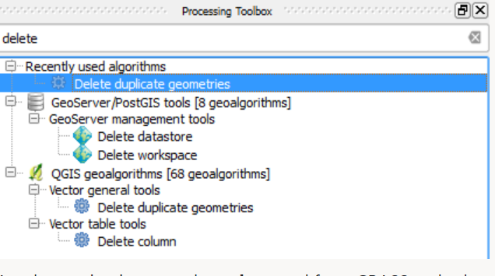
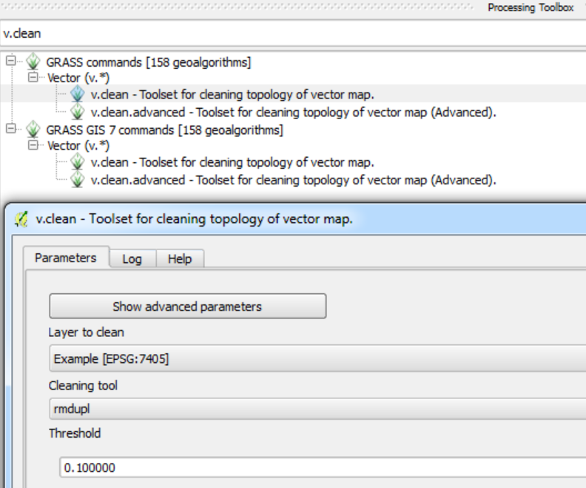
To remove duplicates:
You can use the Delete duplicate geometries tool by accessing it via the Processing Toolbox
Another option is to use the v.clean tool from GRASS and select the rmdupl option:

Slide 9
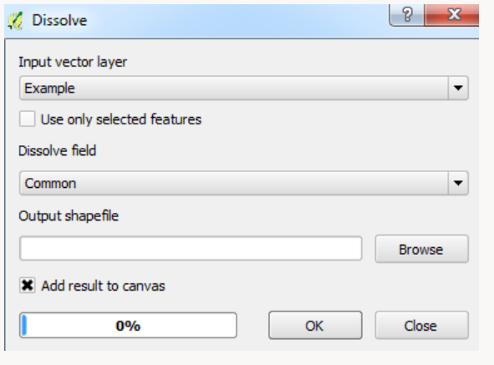
To remove overlaps:
You can use the Dissolve tool, provided there are common attributes between the original polygon and the overlapping polygon
It can also be done via the Attribute Table, find your overlapping polygons (useful in conjunction with a topology checker to highlight the overlaps) and select the option to delete features.

Slide 10
Merging Multiple Vector Layers
To merge multiple vector layers into one layer in QGIS, you can use the Merge Vector Layers tool. Here’s how:
Open QGIS and add the vector layers that you want to merge to the map canvas.
Click on the Processing menu and select Toolbox.
In the toolbox window, search for the Merge Vector Layers tool and double-click on it to open the tool.
In the Merge Vector Layers dialog, select the input layers that you want to merge. You can select multiple layers by holding the Ctrl key while clicking on the layer names.
Specify the output layer name and the output format.
Click Run to execute the tool.
The Merge Vector Layers tool will create a new layer that is the result of merging the selected input layers. The new layer will contain all of the features from the input layers, and the attributes from the input layers will be combined into a single attribute table.

Slide 11
code that generates a new layer that contains features which shows the location of double geometries:
source_layer = iface.activeLayer()
duplicate_geo_id = []
duplicate_id = []
for i in source_layer.getFeatures():
g = i.geometry()
if (g.asWkt() not in duplicate_geo_id):
duplicate_geo_id.append(g.asWkt())
duplicate_id.append(i.id())
source_layer.select(duplicate_id)
source_layer.invertSelection()
new_layer=source_layer.materialize(QgsFeatureRequest().setFilterFids(source_layer.selectedFeatureIds())) source_layer.removeSelection()
new_layer.setName('Double Geometry')
QgsProject.instance().addMapLayer(new_layer)

Slide 12
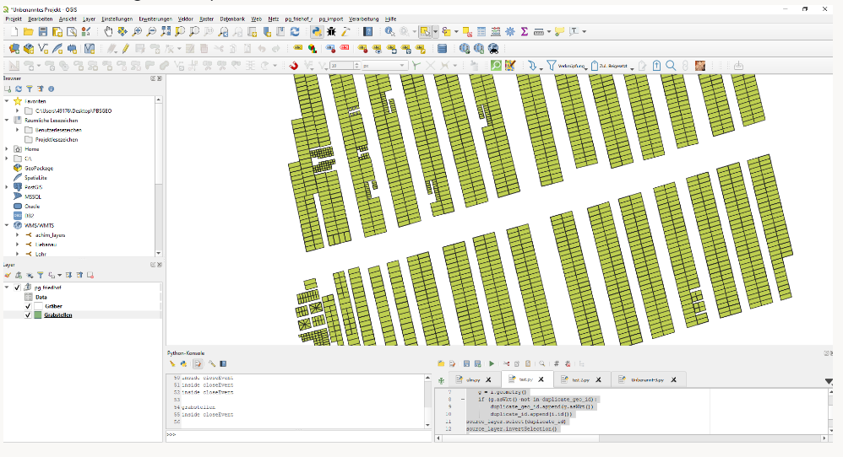
Before executing the script:

Slide 13
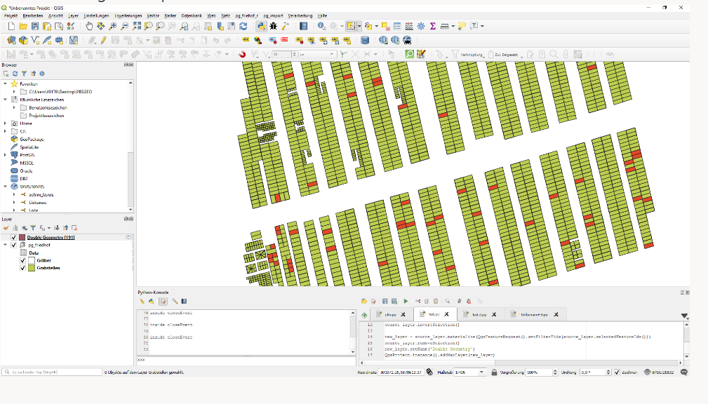
After executing the script:

Slide 14
Contd
Using use Python to merge vector layers in QGIS
by using the ogr2ogr command line tool in a Python script. Here’s an example of how to use ogr2ogr to merge two Shapefiles using Python:
import subprocess
input_file_1 = "layer1.shp"
input_file_2 = "layer2.shp"
output_file = "merged.shp"
cmd = "ogr2ogr -f 'ESRI Shapefile' {} {} {}".format(output_file, input_file_1, input_file_2)
subprocess.call(cmd, shell=True)
This script will merge the two Shapefiles layer1.shp and layer2.shp into a single Shapefile called merged.shp.

Slide 15
Two vector layers using PyQGIS:
Contd
from qgis.core import QgsVectorLayer, QgsProject
# Load the input layers
layer1 = QgsVectorLayer("layer1.shp", "Layer 1", "ogr")
layer2 = QgsVectorLayer("layer2.shp", "Layer 2", "ogr")
# Add the input layers to the map
QgsProject.instance().addMapLayers([layer1, layer2])
# Create a list of the input layers
layers = [layer1, layer2]
# Merge the input layers
output_layer = QgsVectorLayer("Polygon?crs=epsg:4326", "Merged", "memory")
output_layer_data_provider = output_layer.dataProvider()
for current_layer in layers:
output_layer_data_provider.addFeatures(current_layer.getFeatures())
# Add the merged layer to the map
QgsProject.instance().addMapLayer(output_layer)
This script will load the two input layers layer1.shp and layer2.shp, add them to the map, and then merge them into a single memory layer called Merged. The merged layer is then added to the map.

Slide 16
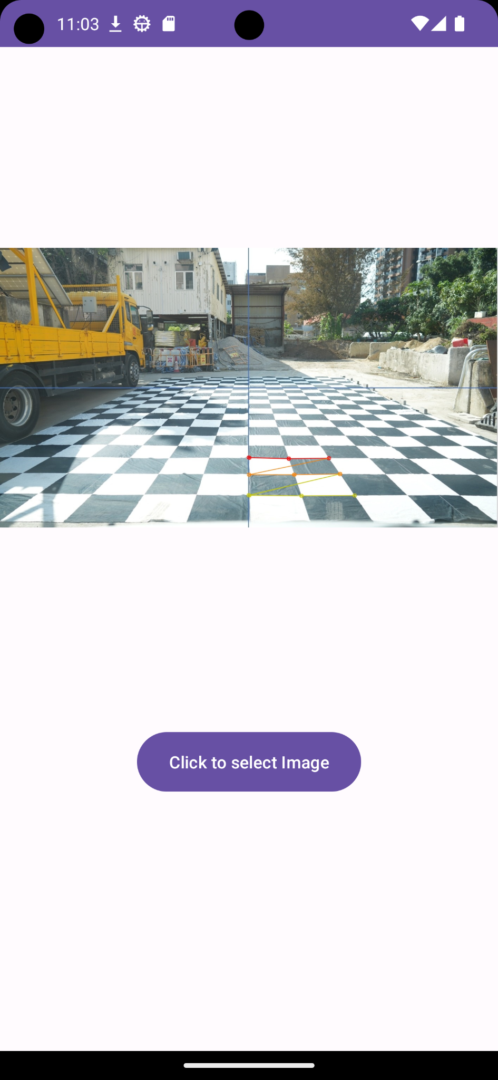

Previous Week Update
App started working
Camera Details

Slide 17
Internal Working
Kotlin
(User taking image)
Byte array
(For Processing)
Python
(Processing of Image)
Byte array
(Processed)

Slide 18

Current Status
Camera Detail Feature is working Text need to be formatted

Slide 19
Future Update
Dept Measurement Feature
Crack Measurement Feature (Height and weight)

